Slide 1


Analysis and Design of Algorithms
Transform Coding
Chapter 4: Recursive Algorithm
School of Software Engineering © Ye Luo

Slide 2

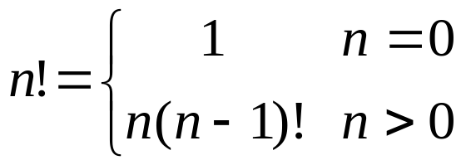
Recursive Algorithm
Recursion :
a procedure or subroutine, whose implementation references itself
Example 1: Recursive evaluation of n !
Iterative Definition
  Recursive definition
initial condition
recurrence relation
Notes:
递归的概念：
直接或间接地调用自身的算法称为递归算法。用函数自身给出定义的函数称为递归函数。
边界条件与递归方程是递归函数的二个要素
每个递归函数都必须有非递归定义的初始值
第二式用较小自变量的函数值来表示较大自变量的函数值的方式来定义n的阶乘

Slide 3
Recursive Algorithm
Example 1: Recursive evaluation of n ! (‘cont)
Algorithm F(n)
  if n=0
  return 1 //base case
  else
    return F (n -1) * n //general case

Slide 4
Recursive Algorithm
Example 1: Recursive evaluation of n ! (‘cont)
to solve recurrences,
method of backward substitutions
C(n)= C(n-1)+1
= [C(n-2)+1]+1 =C(n-2)+2
= [C(n-3)+1]+2 =C(n-3)+3
……
= [C(n-n)+1]+n-1 = n
input size: n
basic operation: multiplication
Times of Basic operation for F(n)
C(0)= 0
C(n)= C(n-1)+1
initial condition
recurrence relation
to find the initial condition, to see when the call stop in the pseudocode
can be proved by mathematical induction

Slide 5

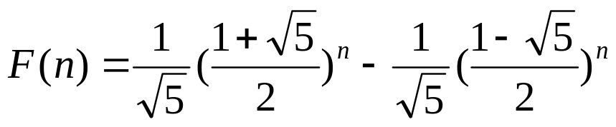
Recursive Algorithm
Example 2: Fibonacci numbers
Iterative Definition
Derivation can be referred to Appendix B-3
C(n) ∈ Θ (φ^{n})

Slide 6
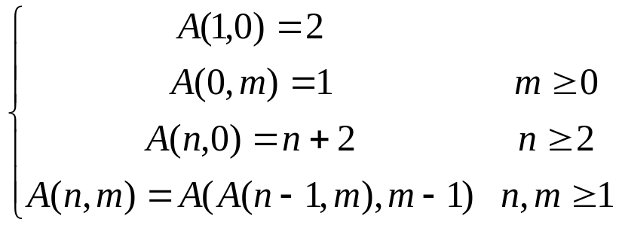
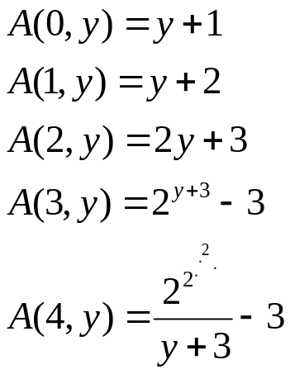
Recursive Algorithm
Example 3: Ackerman Function
  E.g.
  power towers
  Its value grows rapidly, even for small inputs. For example A(4,2) is an integer of 19,729 decimal digits
  No Iterative Definition

Slide 7

Recursive Algorithm
Example 4: The Tower of Hanoi Puzzle
void hanoi(int n, int a, int b, int c)
{
if (n > 0)
{
hanoi(n-1, a, c, b);
move(a,b);
hanoi(n-1, b, a, c);
}
}
  C(1) = 1
  C(n) = 2C(n – 1) + 1 =2^{n}-1 for every n >1
  C(n) ∈ Θ (2^{n})
Notes:
设a,b,c是3个塔座。开始时，在塔座a上有一叠共n个圆盘，这些圆盘自下而上，由大到小地叠在一起。各圆盘从小到大编号为1,2,…,n,现要求将塔座a上的这一叠圆盘移到塔座b上，并仍按同样顺序叠置。在移动圆盘时应遵守以下移动规则：
规则1：每次只能移动1个圆盘；
规则2：任何时刻都不允许将较大的圆盘压在较小的圆盘之上；
规则3：在满足移动规则1和2的前提下，可将圆盘移至a,b,c中任一塔座上。

Slide 8
Recursive Algorithm
Example 4: The Tower of Hanoi Puzzle (‘cont)
Recurrence Relations
input size: the number of disks, n
basic operation: moving one disk
total number of moving : C(n)
  C(1) = 1
  C(n) = 2C(n – 1) + 1 =2^{n}-1 for every n >1
  C(n) ∈ Θ (2^{n})
C(n) = 2C(n – 1) + 1
= 2(2C(n-2)+1)+1 = 2²C(n-2)+2+1=...
= 2^{i}C(n-i)+2^{i-1}+2^{i-2} +...+2+1 =...
= 2^{n-1}C(1)+2^{n-2}+2^{n}-3+...+2+1
= 2^{n-1}+2^{n-2}+2^{n-3}+...+2+1 等比数列
＝(1-q^{n})/(1-q) = (2^{n}-1)/(2-1) = 2^{n}-1
Notes:
https://www.cnblogs.com/tgycoder/p/6063722.html

Slide 9
Recursive Algorithm
Example 5: permutation problem 排列问题
  Recursive algorithm to make all permutations for list {r₁,r₂,…,r_{n}}。
Some Notations:
R={r₁,r₂,…,r_{n}} ，R_{i}=R-{r_{i}}。
perm(R): all permutation for all elements in R 。
(r_{i})perm(X): to add a prefix in front of each permutation in perm(X)
Idea of Recursive perm(R)：
If n=1，perm(R)=(r)，r is the only element in set R；
If n>1，perm(R) consists of (r₁)perm(R₁)，(r₂)perm(R₂)，…，(r_{n}) perm(R_{n}) .
Notes:
(r_{i})perm(X):表示在全排列perm(X)的每一个排列前加上前缀得到的排列。

Slide 10
Recursive Algorithm
Example 5: permutation problem (‘cont)
template <class Type>
void Perm(Type list[], int k, int m)
{ // create all permutation of list [k: m ] with prefix list[0,k-1]
if (k == m) {//only one element to be done
for (int i = 0; i <= m; i++)
putchar(list[i]);
putchar(‘\n’);
}
else // several permutations for list[k: m ] are created by recursive
for (i=k; i <= m; i++) {
Swap (list[k], list[i]);
Perm (list, k+1, m);
// Swap (list [k], list [i]);
}
}
inline void Swap(Type & a, Type & b)
{
Type temp = a; a = b; b = temp; }
Notes:
用的是归纳法
for(i = start; i <= end; i++)
{
swap(a,start,i);
perm(a,start + 1,end);
swap(a,start,i);
}
如果你要求n个数（a[1]...a[n]）的排列，假设你知道了n-1个数的排列，那么n个数的排列就是分别以
a[1]开头，a[2]...a[n]这n-1个数的排列
a[2]开头，a[1],a[3]...a[n]这n-1个数的排列
...
a[n]开头，a[1]...a[n-1]这n-1个数的排列
这就是数学归纳法的思想，逐步减小规模

Slide 11
Recursive Algorithm
Important Recurrence Type
Decrease-by-one recurrences
  A decrease-by-one algorithm solves a problem by exploiting a relationship between a given instance of size n and a smaller size n – 1.
  Example: n!
  The recurrence equation for investigating the time efficiency of such algorithms typically has the form
  T(n) = T(n-1) + f(n)
Decrease-by-a-constant-factor recurrences
  A decrease-by-a-constant algorithm solves a problem by dividing its given instance of size n into several smaller instances of size n/b, solving each of them recursively, and then, if necessary, combining the solutions to the smaller instances into a solution to the given instance.
  Example: binary search.
  The recurrence equation for investigating the time efficiency of such algorithms typically has the form
    T(n) = aT(n/b) + f (n)

Slide 12
Recursive Algorithm
Decrease-by-one recurrences
  One (constant) operation reduces problem size by one.
T(n) = T(n-1) + c T(1) = d
    Solution: T(n) = (n-1)c + d linear
  A pass through input reduces problem size by one.
    T(n) = T(n-1) + c n T(1) = d
    Solution: T(n) = [n(n+1)/2 – 1] c + d quadratic
T(n) = T(n-1)+cn =T(n-2)+c(n-1)+cn =...
=T(1)+c[2+...+(n-1)+n]

Slide 13
Recursive Algorithm
Decrease-by-a-constant-factor recurrences
– The Master Theorem
T(n) = aT(n/b) + f (n), where f (n) ∈ Θ(n^{k}) , k>=0
a < b^{k} T(n) ∈ Θ(n^{k})
a = b^{k} T(n) ∈ Θ(n^{k} log n )
a > b^{k} T(n) ∈ Θ(n^{log b a})
  Example:
    T(n) = T(n/2) + 1 Θ(logn)
    T(n) = 2T(n/2) + n Θ(nlogn)
    T(n) = 3 T(n/2) + n Θ(n^{log}₂³)

Slide 14
Summary
递归的边界条件和递归方程是递归的两个要点
递归的类型：减一，减常数因子，减不固定因子
递归的简单形式会掩盖递归的非高效性

